Slide 1
Sentiment Analysis on Tweets
Springboard Data Science Track 2nd Capstone Project
Mia Zong
Dec. 2018

Slide 2
Project Description
Essentially a binary classification task with special processing approaches on the text data.
Goal:
determine whether the Twitter users’ attitude towards products from two particular brands, Apple and Google, is positive or negative;
provide feedback based on the Twitter messages.
Data:
retrieved from the website, Figure Eight.
contains three columns -- tweets, brands tweets’ emotions are directed at, and the emotions, and 9093 samples

Slide 3
Project Description Cont.
Important Techniques
For data processing:
LancasterStemmer
WordNetLemmatizer
CountVectorizer
TfidfVectorizer
For classification:
MultinomialNB
Support Vector Machine (SVM)
Hyper-parameter tuning in a pipeline

Slide 4
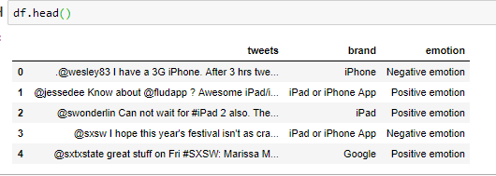
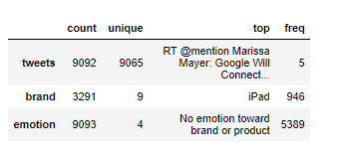
Data Processing
Many different values in the ‘brand’ column.
Need to see how many unique brands in this data set and what they are.
Notes:
Just from the first five rows, it looks like this data set contains tweets on more than one brand's products. Let's discover how many different brands these tweets are about.

Slide 5
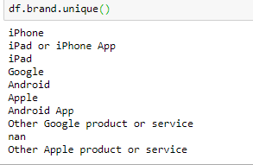
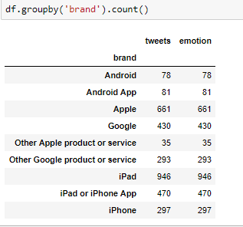
Data Processing Cont.
Mainly two brands -- Google and Apple.
Data set split into two parts based on brands.
Notes:
It seems like tweets are mainly about products of two brands -- Google and Apple. I am going to divide the data into two parts based on the brands. For those tweets which have 'Android' and 'Android App' as brand, you can't tell which specific brand's products they are about, so those tweets will be dropped. I will build the model using tweets about Apple products. After the model is finalized, I will test on the data of Google products to see whether the model can use on data about a different brand, in other words, how generalized the model is.

Slide 6
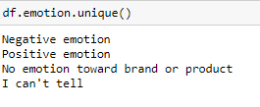
Data Processing Cont.
Only Negative and Positive Emotions Needed.
Notes:
Moreover, this data set has four emotions: ‘Negative emotion’, ‘Positive emotion’, ‘I can’t tell’, and ‘No emotion toward brand or product’. Only two are the ones that matter in this project -- positive emotion and negative emotion. Thus, the samples with emotions other than positive or negative will be ignored.

Slide 7
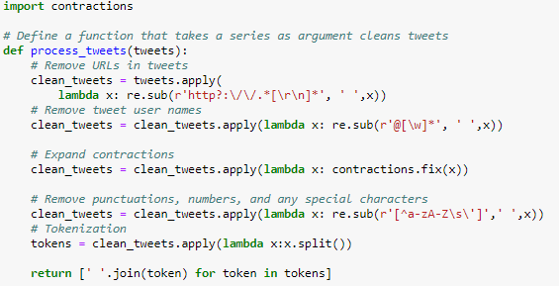
Data Processing Cont.
Data Cleaning
Remove URLs, Twitter Usernames (@...)
Expand Words Contractions
Remove any Punctuations, Numbers, and Special Characters
Notes:
Now, the tweets need cleaning. Remove the URLs, tweet user names (@something), any punctuations, numbers, and special characters. Then tokenize the tweets. Before all the punctuation taken off, I will expand the contractions of words first as the contractions can result in misinterpreting the meaning of a phrase, especially in the case of negations. In other words, the main goal to use the package, contractions, is to avoid the misinterpreting any negations. Thus, phrases, such as '' year's '', are not going to be expanded. For more information on this package, please see here.

Slide 8
Data Processing Cont.
Data Processing:
On X:
Words Stemming
Lemmatization
CountVectorizer (Bag of Words)
TfidfVectorizer (Term Frequency - Inverse Document Frequency, TF-IDF)
On y:
Positive Emotion → 1
Negative Emotion → 0

Slide 9
Data Processing Cont.
Words Stemming & Lemmatization
Both aim to get the root of words, but different in approaches
Stemming chops off the end of words iteratively, thus tends to overstem and returns non-linguistic words
Lemmatization follows the morphological analysis of words
Compare models trained by original words pulled out from tweets directly, word stems, and lemmas.
Implementations of these two technique I used in python is the LancasterStemmer and the WordNetLemmatizer from the NLTK library.
Notes:
Furthermore, I create two functions to normalize the tweets even more by stemming words or lemmatizating words. The goal of both stemming and lemmatization is to get the root forms of derived words, but they differ in their approaches. Stemming usually just chops ff the ends of words. Lemmatization uses the morphological analysis of words. Ronald Wahome claims that the above two techniques may not work so well because they essentially shorten words to their base words and the Twitter messages are short messages by design. I still would like to try the two methods and to see whether they would make a distinct difference on improving my model. There many different implementations for stemming and lemmatization in python, I use the LancasterStemmer and the WordNetLemmatizer from the NLTK library.

Slide 10
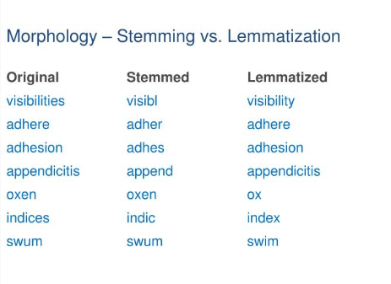
Data Processing Cont.
Stemming V.S. Lemmatization Examples
[Image Source]
Back

Slide 11
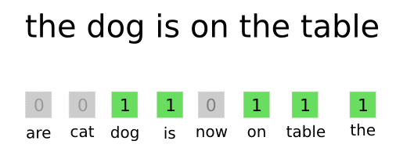
Data Processing Cont.
Convert Text to be numerical
Bag of Words
Counts of the words in each Twitter
CountVectorizer in NLTK
Notes:
Last step in the data process section is to convert the cleaned tweets, which now are lists of words, to be numerically represented. I explore two techniques in this projects -- Bag-of-Words (BOW) and TF-IDF. Bag-of-Words approach is like to look at the counts of the words in each Twitter messages. The implementation, CountVectorizer, in sklearn this BOW approach. It counts the occurrences of words and builds a sparse matrix of the counts. Moreover, the target variable, emotion, needs converting to. It is transformed to a binary variable where 0 means negative emotion and 1 means positive emotion.

Slide 12
Data Processing Cont.
Convert Text to be numerical
Term Frequency - Inverse Document Frequency (TF-IDF)
Term frequency is words’ counts
Inverse document frequency is a measure of how much information a particular word provides
TF-IDF tends to reflect how important a word is to a document
TfidVectorizer from the NLTK library
Map ‘0’ to negative emotion and ‘1’ to positive emotion so that the target variable is numeric as well.
Notes:
TF-IDF is short for term Term Frequency - Inverse Document Frequency. It is the product of term frequency and inverse document frequency.The term frequency is simply words’ counts. The inverse document frequency is a measure of how much information the word provides, i.e. if it is common or rare across all documents. TF-IDF is intended to reflect how important a word is to a document. In other words, if a word occurs in every tweets regardless the sentiment of the tweets, then this word give little information. Its TF-IDF score is 0 or very close to zero. The implementation in sklearn is called TfidVectorizer. These two methods will be compared during the model training process.

Slide 13
Train Models
Steps:
Choose the best combo of the transformation method for words to be numeric and the algorithm to train the model.
Tune the hyper-parameters to get the best model
Try to use words’ stems and lemmas to train models and compare the models with the best model trained by words only.
Test on Google data to see how generalized models are and choose the one is better generalized.

Slide 14
Train Models Cont.
Algorithms
Two classification algorithms -- MultinomialNB and SVM
Two words transformation approaches -- CountVectorizer (BOW) and TfidfVectorizer (TF-IDF)
Compare the accuracy scores of two combinations of words transformation approaches and classification algorithms.
Notes:
I will try two classification algorithms, the Multinomial Naive Bayes classification and the Support Vector Machine (SVM). Please recall that I have two approaches to convert the Twitter texts to numeric values, so that makes total four different combinations of text transformer and classifier.

Slide 15

Train Models Cont.
Results
Notes:
After comparing the accuracy score on training data and test data, the best combination is to convert the tweets by CountVectorizer and train the model with Multinomial Naive Bayes classifier.

Slide 16
Train Models Cont.
Hyperparameter Tuning with A Pipeline:
Transformation and the classification can be cross-validated together.
Tuned parameters:
CountVectorizer:
max_df and min_df -- ‘ignore’ frequency
binary
MultinomialNB:
Alpha: smoothing parameter
GridSearchCV
Notes:
Next, I do a hyperparameter tuning with a pipeline so that the transformation and the classification can be cross-validated together while setting different parameters. The tuning is about the maximum and minimum document frequency, terms have higher or lower frequency than which will be ignored when building the vocabulary during words converting. The additive smoothing in MultinomialNB is tuned as well. The technique used in the hyperparameter tuning is the GridSearchCV in sklearn.

Slide 17
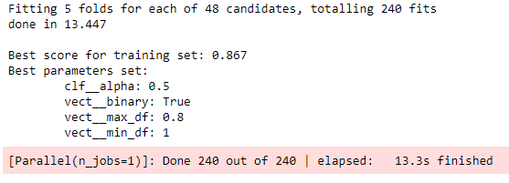
Train Models Cont.
Hyperparameter Tuning with A Pipeline Cont.
Notes:
The best score is 0.863 on the training data set and 0.875 on the test data set. The test score is even a little bit better than the training’. It seems like a great result, but it is not really like that. I will explain why shortly.

Slide 18
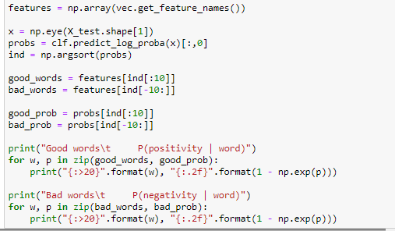
Extract Important Predictive Words
Notes:
The best model is achieved after hyperparameter tuning done. I would like to extract the strongly and weakly predictive features. In other words, I want to see what words my model learns that indicate positivity the most and what words indicate negativity the most.
I need to use the get_feature_names method from the CountVectorizer convector to get the actually words. An identity matrix is used to create a matrix that each row has exactly one word. Then, I use the trained MultinomialNB classifier to predict on this matrix. Finally, sort the rows by predicted probabilities, and pick the top and bottom 10 rows.

Slide 19
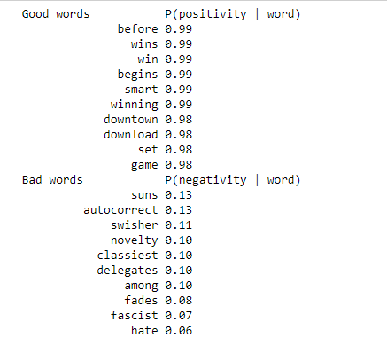
Extract Important Predictive Words Cont.
Top 10 Most Positive and Most Negative Words
Notes:
The outcomes are not exactly as good as when looking at the top 10 positive words, anyone will agree that they would think these words mean positive or negative. For instance, set, congress, and begins are listed in the top 10 strongest predictive words, but when I think of them, I don't really have any emotion towards them. Some words in the weakest predictive words make few sense, such as classiest and novelty. These words definitely indicate positiveness to me. I am not sure why my model would learn that they are the top 10 negative words, unless they are used sarcastically very often in my data set. Moreover, I notice that both win and wins appear in the top 10 strongest predictive words list, but clearly win and wins mean the same thing. Thus, I think I should try word stemming and lemmatization and see if that could help improve my model.

Slide 20
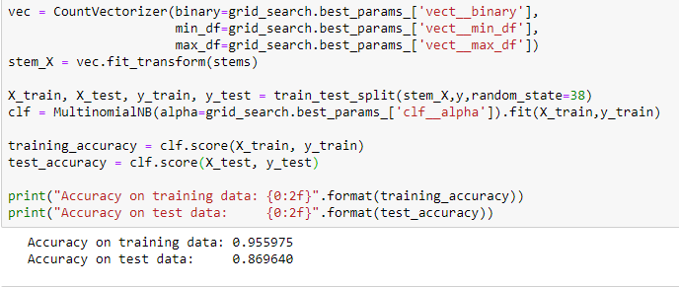
Try Word Stemming and Lemmatization
Notes:
I use the two functions defined earlier to get the word stems as well as verb lemma and noun lemma as my data. Then I perform the transformation and the classification process on the stems and lemma as before. Here are the results:

Slide 21
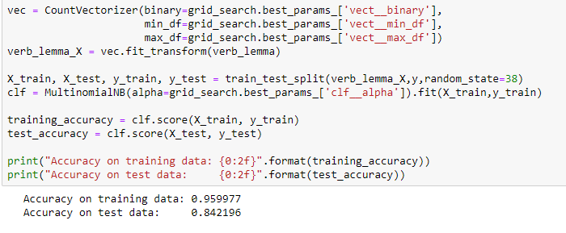
Try Word Stemming and Lemmatization Cont.

Slide 22
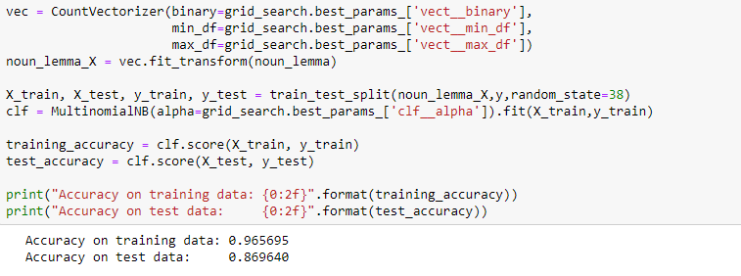
Try Word Stemming and Lemmatization Cont.

Slide 23
Try Word Stemming and Lemmatization Cont.
To Sum up the results:
 | Accuracy Score on
 | Training Data | Test Data
Word Stems | 0.956 | 0.870
Verb Lemmas | 0.960 | 0.842
Noun Lemmas | 0.966 | 0.870
Notes:
It looks like using word stems to train this MultinomialNB classifier performs the best on test data.
Please recall that at the very beginning, I split the original data set into two parts based on the two different targeted brands-- Google and Apple.And my goal is to build an as generalized as possible model such that can be used to predict tweets about many brands. By far, I have been using only the data about Apple products. Now I will compare the accuracy scores of using my four models to predict the tweets on Google products to make the final decision on which model is going to be my final model. The difference among those models are the data set used to train them.

Slide 24
Comparing Four Models
 | Accuracy Score on
 | Training Data | Test Data | Google Data
Words | 0.969 | 0.825 | 0.754
Word Stems | 0.956 | 0.870 | 0.761
Verb Lemmas | 0.960 | 0.842 | 0.745
Noun Lemmas | 0.966 | 0.870 | 0.735
Notes:
It looks like the best model is the one trained with word stems as it has the best score on test data and Google data in multiple runs.. Let’s take a look at the top 10 strongest and weakest predictive words of this model:

Slide 25
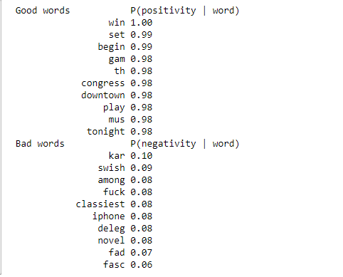
Top Features from Model Trained by Word Stems
Notes:
Please note that there are some word stems in the above list do not seem like proper English words. That is what one may get when using the LancasterStemmer. LancasterStemmer tends to be heavy stemming, which leads stems to be non-linguistic. But it does give the best classification accuracy among my four models.

Slide 26
Conclusion and Thoughts
The classification model built with word stems data is good at classifying the sentmenti of Twitter messages towards brands and it can be considered as a generalized model.
The model might not be a good fit to provide brands with readable feedback from Twitter users.
Notes:
The classification model built with word stems data has a good accuracy score on test set and it can be considered as a generalized model since the accuracy score on a completely new data set, the tweets about Google products, is 0.787. My first goal of this project is achieved. However, I am not really sure whether this model is able to provide brands with readable feedback from Twitter users.
In other words, brands and companies do not only care about whether customers have good feeling at their products or they have bad experience with the products, but also, if not more, care about how to improve the products or what features they would like to keep. My intention is to build a model that predicts the tweets’ sentiment and is able to provide meaningful key words by extracting the strongest and weakest predictive features. However, this model does not accomplish the second goal. Part of the reason is using the LancasterStemmer algorithm, which tends to overstem and returns non-linguistic ‘words’.

